Slide 1

University of Basrah College of Nursing
Management &Leadership in Nursing
Management in Nursing
First lecture
Prepared by:- assist lect. Hazim naeem waheeb
22/01/2025

Slide 2
Outlines
Management in Nursing
Definition of Management
Definition of manager , Roles performed by managers
Management needs / resources
Management process
Levels of management
Principles of management
Function of the management
Factors effecting on management
Theories in nursing management

Slide 3
Management or administration may be defined as the art of securing maximum results with a minimum of effort so as to secure maximum prosperity and happiness for both employer and employee and give the public the best possible service.
Nursing management is the process of working through nursing personnel to promote and maintain health and prevent illness and suffering.

Slide 4
A manager: is formally or officially responsible for the work of a given group.
Roles of the Manager
1. Creating the Vision
2. Implementing the Vision
3. Facilitating Change
4. Mentoring
5. Gathering Information
6. Evaluating Information
7. Communicating
8. Decision-Making
9. Building Relationships
10. Controlling Climate

Slide 5
Management Needs Resources
1. The Director of Nursing Resource Management
This individual directs the management of the staffing and payroll
functions, nursing supervisors, and the nurse manager of the organization.
2. The Staffing and Payroll Office
This office is responsible for providing support to the inpatient nursing
units and the emergency department for scheduling, staffing and payroll. Its responsibilities include daily staffing, maintaining scheduling changes.

Slide 6
3. Nurse Manager
This individual manages the staff of the organization and the 24-hour
operations of the holding areas.
4. The Nursing Staff
is comprised of the following positions: registered nurse, certified nursing assistants, unit secretaries, and nursing service aides.

Slide 7
Management Process
The management process, like the nursing process, includes gathering data, diagnosing problems, planning, interviewing and evaluating outcomes. But in reality each step of the management process is more complex than the nursing process.
The management process consists of working with human and physical
resources and organizational and psychological processes within a creative
and innovative climate for the realization of organizational goals.
Elements of management Process
Planning, Organization ,Staffing, Directing, Coordinating,
Reporting and Budgeting .

Slide 8
Levels of Management Generally, there are Three Levels of Management.
1. Top Level Management
As the nurse director, responsible for managing nursing departments in the hospital, and all middle managers report to him.
The main role of the First level manager
1. Determines the objectives, policies and plans of the organization.
2. Mobilizes available resources.
3. Does mostly the work of thinking, planning and deciding. Therefore,
they are also called as the Administrators and the Brain of the organization.
4. They spend more time in planning and organizing.
5. They prepare long-term plans of the organization which are generally
made for 5 to 20 years

Slide 9
2: Middle Level Management
The middle level management emphasize more on following tasks:
1. It gives recommendations (advice) to the top level management.
2. It implements the policies and plans which are made by the top level management.
3. It co-ordinate the activities of all the departments.
4. They also have to communicate with the top level Management and
the lower level management.
5. They spend more time in coordinating and communicating.
6. They prepare short-term plans of their departments which are
generally made for 1 to 5 years.

Slide 10
3: Lower Level Management .
The lower level management consists of the Foremen and the Supervisors.
The lower level management performs following activities :
1. Lower level management directs the workers / employees.
2. They develops morale in the workers.
3. It maintains a link between workers and the middle level management.
4. The lower level management informs the workers about the decisions which are taken by the management. They also inform the management about the performance, difficulties, feelings, demands, etc., of the workers.
5. They spend more time in directing and controlling.
6. The lower level managers make daily, weekly and monthly plans.

Slide 11
The 14 Principles of Management described by Henri Fayol.
1. Division of Labor
2. Party of Authority & Responsibility
3. Principle of One Boss
4. Unity of Direction
5. Equity
6. Order
7. Discipline
8. Initiative
9. Fair Remuneration
10. Stability of Tenure
11. Scalar Chain
12. Sub-Ordination of Individual Interest to General Interest
13. Espirit De’ Corps (can be achieved through unity of command)
14. Centralization & De-Centralization

Slide 12
Factors Effecting on Management
1. The degree to which management's decision making style affects
information flow.
2. The types of technology used in the performance management
system to generate and process information.
3. The level of use of e-commerce and Internet technologies to facilitate the flow of information.
4. Competition : health Care Setting that do not jump quickly into a promising service market may be outmaneuvered by their competitors.

Slide 13
5. Economy: the overall economy or health of the company's industry also may negatively affect a manager's ability to plan.
6. Managers: if they are not good planners in general or do not have the experience, education or background in planning required to be successful, they are more likely to plan poorly.
7. Information: when planning occurs, it is vital to have accurate information from consumers, the market, the economy, competitors and other sources.

Slide 14
Theories in Nursing Management
Henri Fayol , 1925, first identified the management functions of Planning,
Organization, Command, Coordination, and Control.
Later, Luther Gullick, 1973, expanded these and introduced seven activities
of management :Planning, Organization ,Staffing, Directing, Coordinating,
Reporting, and Budgeting ( POSDCORB)
They could be categorized into four main focuses.
1. Scientific Management.
2. Classic Organization .
3. Human Relations .
4. Behavioural Science

Slide 15
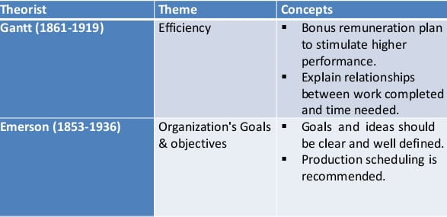
Management Theories
Scientific Management Theories

Slide 16
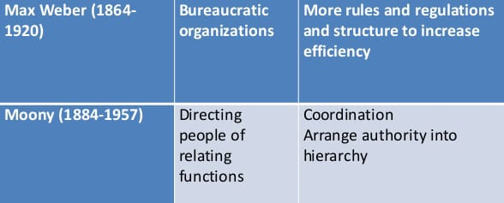
B: Classic Organization

Slide 17
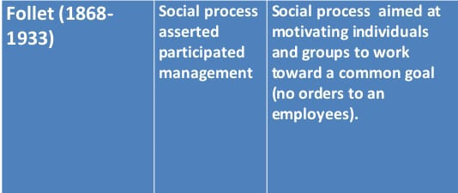
C: Human Relation

Slide 18
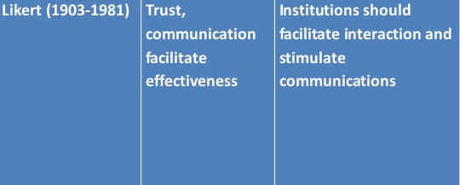
D: Behavioral Science

Slide 19
REFERENCES
Mary Ph.D., SoheirMekhamer, Ph.D., ValsamaJoshy: Introductgion to
Leadership and Management in Nursing. Oman health Institutes Curriculum, Muscat,January 2006.

Slide 20
Home work
Define the management and numerate the levels of management ?
Define the manager and numerate the roles of the Manager?
Elements of management Process ?
Numerate the Theories in Nursing Management?

Slide 21
THANK YOU

